Slide 1
MALIGNANT COMMENTS CLASSIFIER
Submitted by: Submitted to:
Aayushi Lashkari Mr. Shubham Yadav

Slide 2
Contents
Problem Statement
Data Analysis
Pre Processing Pipe Line
Data Modelling
Conclusion

Slide 3
Problem Statement
The proliferation of social media enables people to express their opinions widely online. However, at the same time, this has resulted in the emergence of conflict and hate, making online environments uninviting for users. Although researchers have found that hate is a problem across multiple platforms, there is a lack of models for online hate detection.
Our goal is to build a prototype of online hate and abuse comment classifier which can used to classify hate and offensive comments so that it can be controlled and restricted from spreading hatred and cyberbullying.

Slide 4
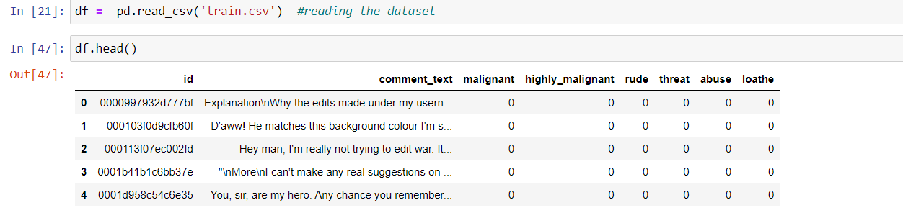
Data Analysis
The dataset consist of 1,59,000 rows and 8 columns , It is a multi label classification problem where we need to find the category of comments between six categories.

Slide 5
Independent Features
Number of independent features are two .
One is Id which is unique for each row and will not contribute for the model building.
Second and the only feature which will be useful in finding the type of comments is comment text.

Slide 6
Dependent Variable
There are six different dependent variable
Malignant , Highly Malignant , rude , threat , loathe , abuse .
Each is the different type of comment which has to be classify.
Each label is highly imbalanced in nature.

Slide 7
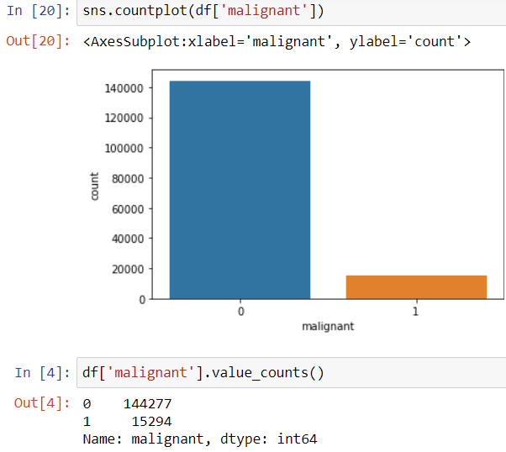
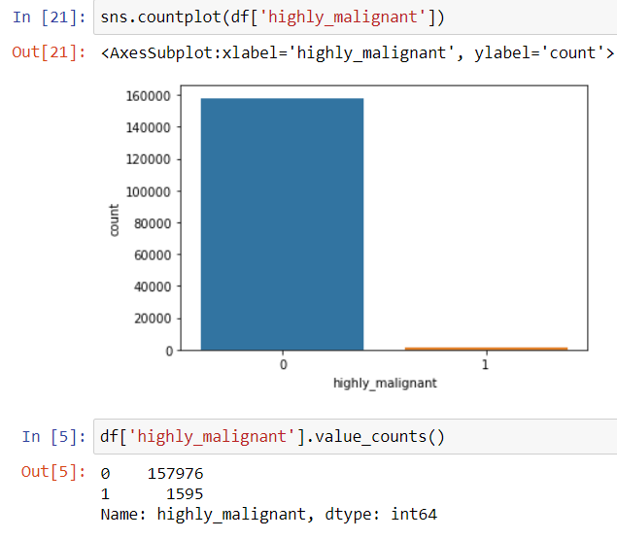
Glance at some label count plot

Slide 8
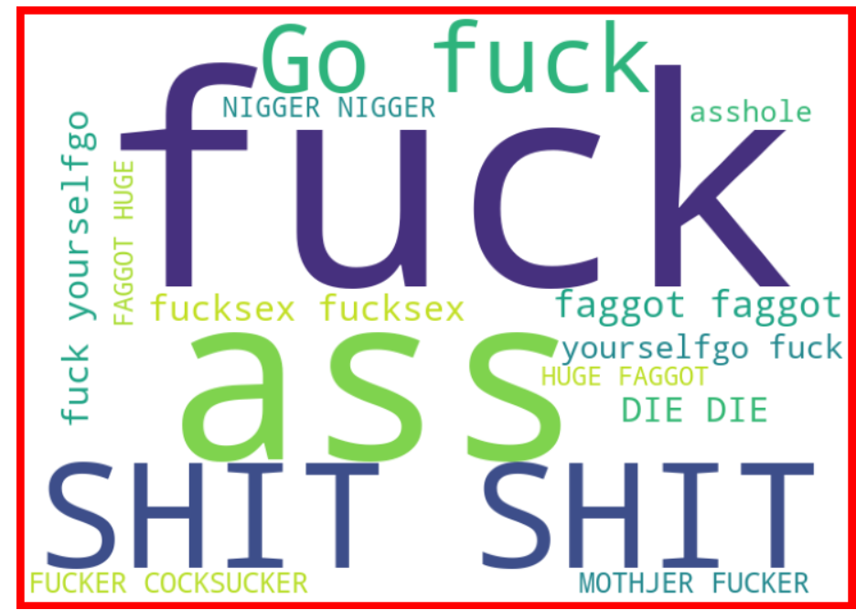
WORD CLOUD
Frequent words used in Highly Malignant comments

Slide 9
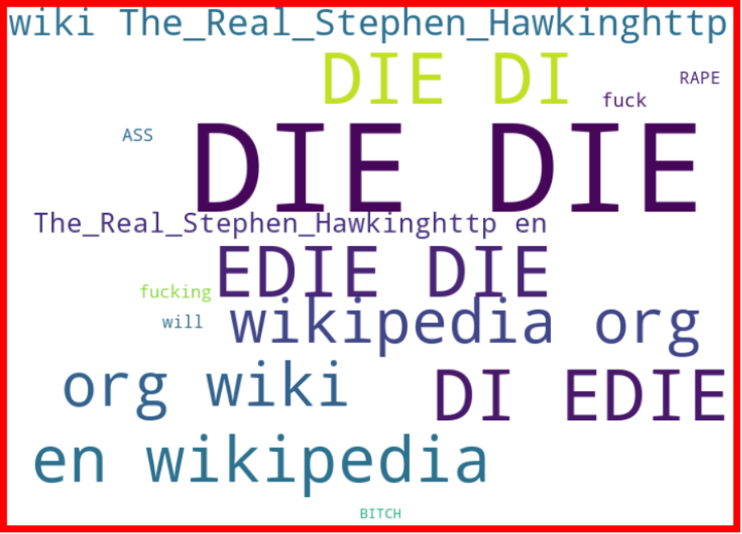
COMMENTS WHERE EACH LABEL IS PRESENT

Slide 10
Approaches For Pre Processing
Finding the null values
Preprocessing of comment text :
Removing stop words
Removing punctuation
Removing urls
Removing phone numbers
Removing special characters

Slide 11
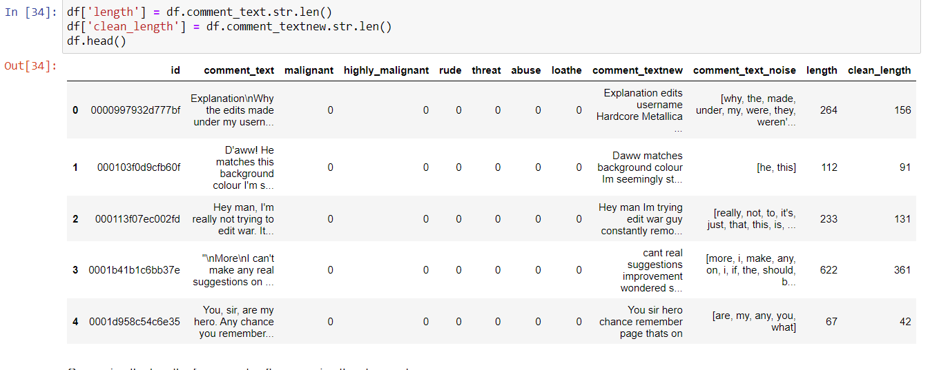
Dataset after pre processing

Slide 12
Data Modelling
This is an multi label classification.
Algorithms that I have used:
OneVsRestClassifier , Binary Relevance , Label PowerSet
Ensemble Techniques like Random Forest , Gradient Descent and
Ada Boost Classifier

Slide 13
Metrics Used
Metrics I have used is Accuracy score , Hamming Score , Classification report and confusion matrix.
Compared the best model based on the Accuracy and hamming score.
Pain Points:
As data is large takes large time to process .
Data cleaning should be done properly.

Slide 14
Conclusion
Data is large in size leads to increased time and CPU utilization.
Each label is highly imbalanced.
Tried to apply possible technique.
Helpful to learn how to handle multi label classification.
Points to improve :
Hyper parametric tuning

Slide 15
THANK YOU

